Slide 1

拉布喵饲养手记
Otocolobus mu laboratorium
周梦宇
2016-03-18
Lab μ 小动物烹饪协会 诚意出品

Slide 2


¡Bienvenidos a Lab μ!

Slide 3
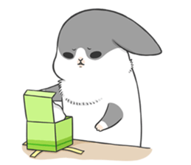
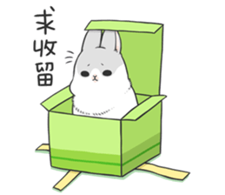
What? Why?
Dreams! Hopes!

Slide 4


Lab μ是由清华大学具有极客精神的同学组成的科创社团，我们用工匠与画家的眼光来重新设计和塑造身边的日常，并通过协力开发全新的互联网、移动和桌面应用等产品来简化校园生活。
* 多个深受师生欢迎的应用已发布或开发中，如TUNet校园网自动连网助手、Tsinghua Now即刻清华应用、CaμsKit校园活动套件等，更多有趣实用的想法正被一步步实现！
* Lab μ汇集了校园顶尖的工程师、设计师和创造力行动力max的同学，我们通过多种平台大型项目的设计、开发、宣传、运营等活动，为团队成员提供了有效的交流和学习平台。
design
tinker
marketing
innovate
hack
product

Slide 5
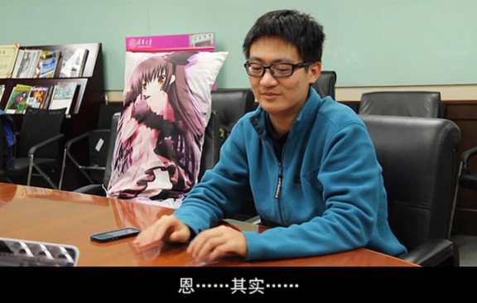
Screen recorded with all the ❤ in the world by Lab μ 拜闪被piā一脸协会

Slide 6




TUNet
Tsinghua Now
CaμsKit
Built with all the ❤ in the world by Lab μ Greek House

Slide 7
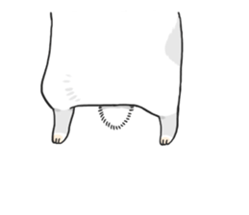
Veni, vidi, vici.
Make it happen
rightly, successively.
-Gaius Julius Caesar

Slide 8
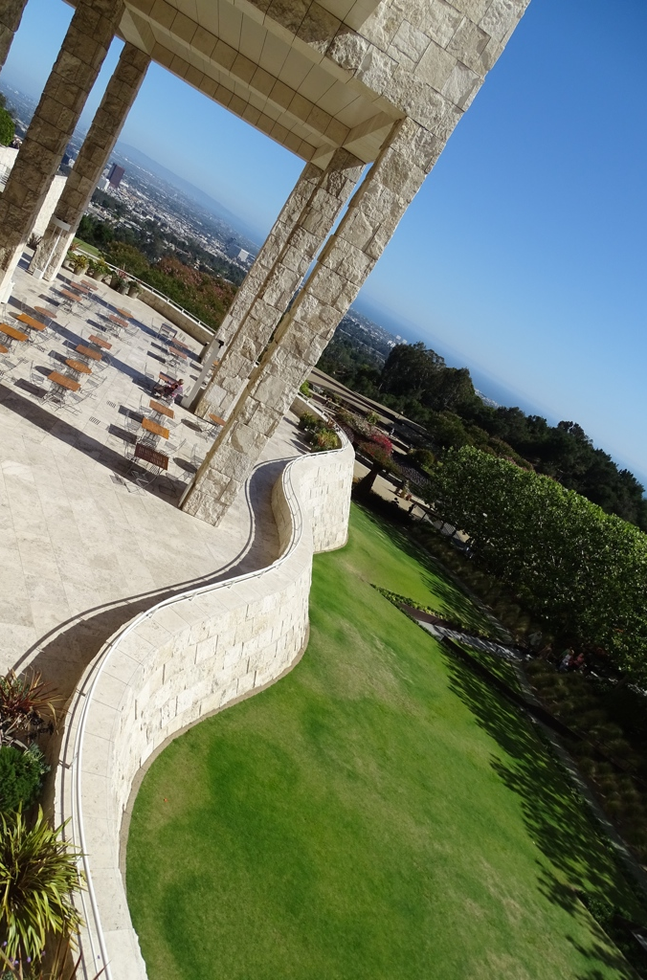
Reframe & Tinker
Think! Act!
differently
creatively
actively
The Art of…
Programming
Design
Marketing
Collaboration
etc.
The Getty Center, LA (Richard Meier)

Slide 9
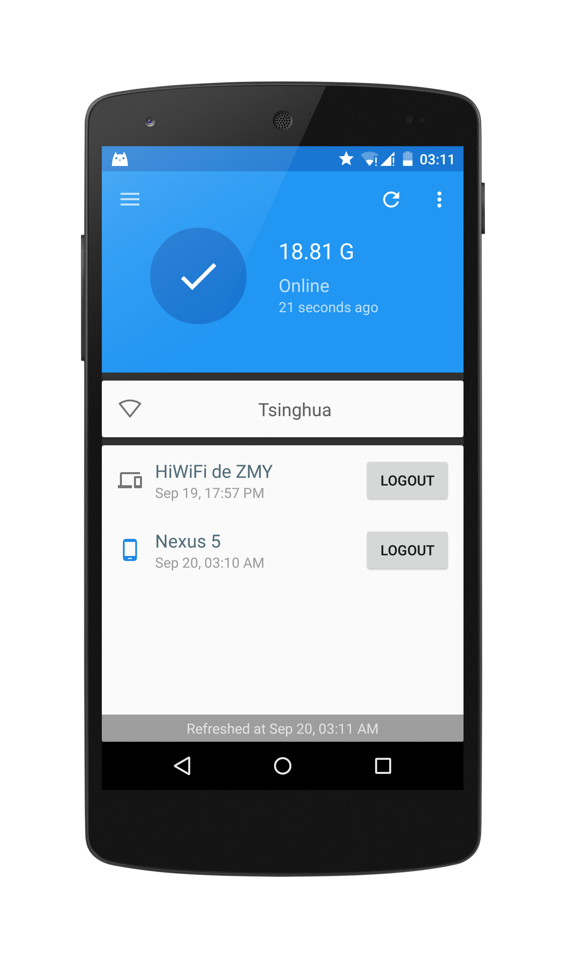
Build Products for our Customers
Quality
Every pixel matters!
Who is our customer?
persona
market
…
What we can do for our customers?
simplify
filter
…

Slide 10
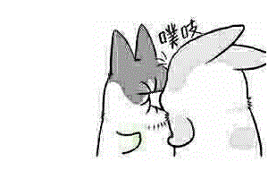
Collaborate
Communication
Empathy
Open hearted
Encourage
Non-zero-sum

Slide 11
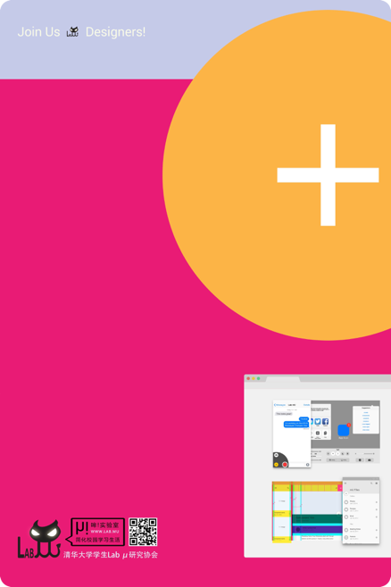

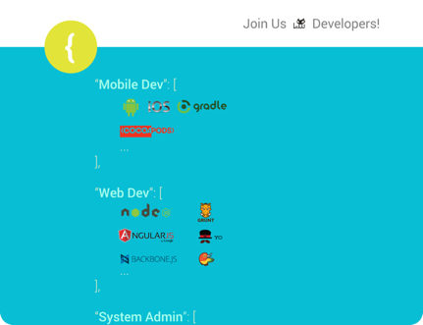


Slide 12

心
野心、雄心、耐心、不怂、稳、专心…

Slide 13
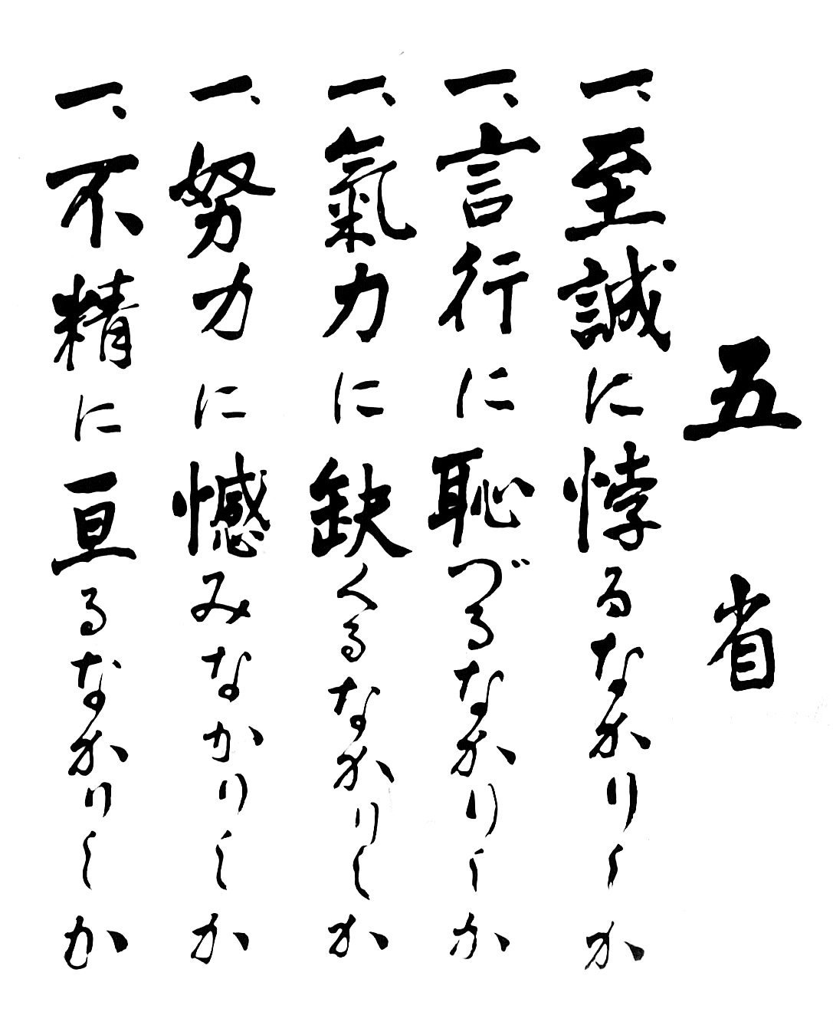
-海軍兵学校

